Slide 1
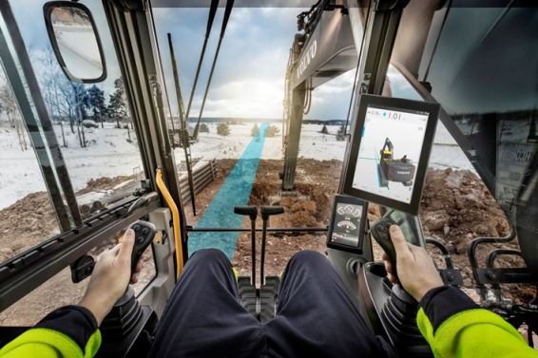
Co Pilot driver statistics project
11/18/2016
Team members:
Vladimir Djukanovic
Leslie Dahlberg
Léa Brunschwig
Eric Engtorp
Fredrik Frenning
Pooria Ghavamian
Hamza Sabljakovic

Slide 2
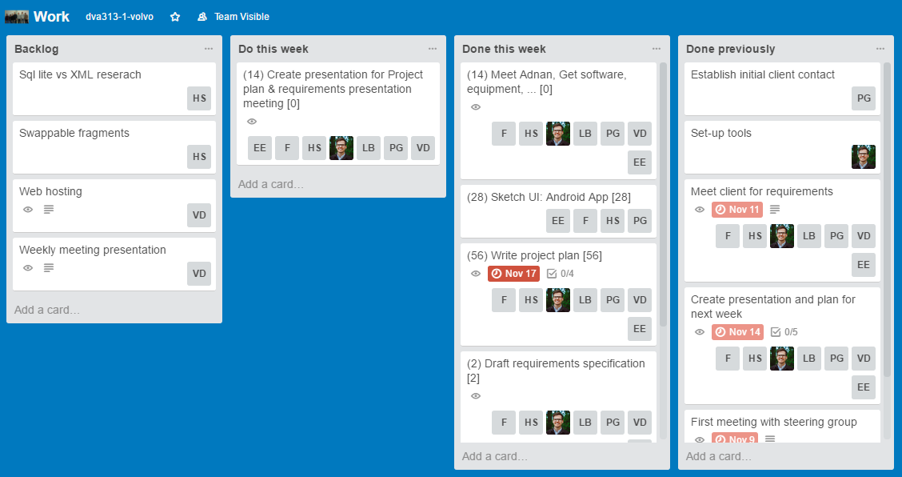
Trello – last week

Slide 3
Last week - establishments
Requirements specification
Sketch UI (3 different concepts)
Android app
Web portal
Report for client (including documentation that describes different concepts and functionality)
Project plan
Sketch concept approved by client
Meeting with Adnan and discussing Co Pilot hardware and how to run application on it (requirements for android studio and project itself that will enable running application on Co Pilot)

Slide 4
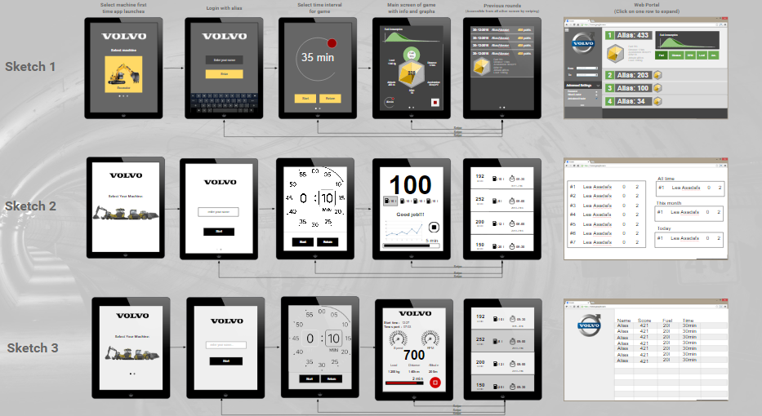
Sketches

Slide 5
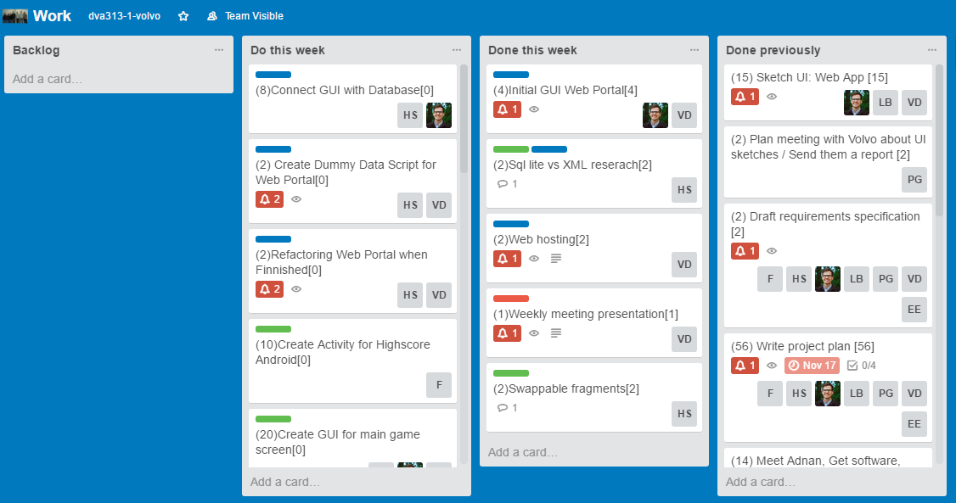
Trello – following week

Slide 6
Plan for following week
Create presentation for project plan meeting
Set up web portal and android application project
Choose web hosting service
Initial implementation
Web portal
Android application
Web Portal implementation:
Create database schema
Create Database API, setup scripts, etc
Create API for uploading data
Create Dummy Data Script
Connect GUI with Database
Refactoring when finished
Android application implementation:
Find Graph Library
Create initial algorithm for score and determine what data to measure and store
Set Up Sql lite
Initial navigation and basic activities Android (Swiping, highscore, game, selecting machines, etc.) without detailed implementation of individual activities
Create upload highscore function for Android
Create GUI for main game screen
Create Activity for Highscore

Slide 7
Obstacles
Co Pilot responsiveness
Different GUI in compare with standard Android

Slide 8
Worked hours
Name | Last week | Total
Vladimir Djukanovic | 15 | 30
Hamza Sabljakovic | 15 | 30
Léa Brunschwig | 15 | 30
Eric Engtorp | 20 | 35
Fredrik Frenning | 20 | 35
Pooria Ghavamian | 20 | 35
Leslie Dahlberg | 20 | 35

